Slide 1
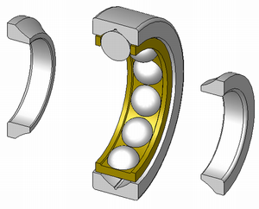

Demystifying
Demodulation
for
Rolling Element Bearing Analysis
Dennis Shreve
GE-Bentley / Commtest Instruments
1
VI –Southern Indiana
10/03/2013

Slide 2
Rolling-Element Bearing Analysis
There are lots of product offerings, tools, and techniques available.
Sometimes just making the choices can be a bit intimidating and overwhelming.
We need to take away some of the “mystery”.
We need to make the best of the technology.
We will now examine the history, scientific terminology, and industry jargon.
2
VI –Southern Indiana
10/03/2013

Slide 3
Getting Down to Basics
A bearing carries the load by round elements placed between two pieces.
Relative motion of two pieces causes rolling, with very little resistance or friction.
Started with logs on the ground with a stone block on top! (Log at back was moved to front, sequentially.)
Rolling elements in a circular bearing are captive and do not fall out under load.
Rolling-element bearings offer a good trade-off on cost, size, weight, carrying capacity, durability, accuracy, low friction, ….. and the list goes on.
3
VI –Southern Indiana
10/03/2013

Slide 4
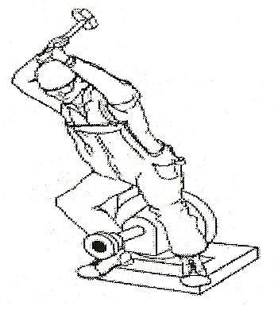
Why Do Bearings Fail?
Poor design.
Misapplication.
Poor installation.
Improper loading.
Improper staging and handling.
Poor care and maintenance.
Poor installation.
Design Engineering – Application Engineering – Maintenance
4
VI –Southern Indiana
10/03/2013

Slide 5
Facts on Bearing Life / Failure
Less than 10% achieve design life. **
16% fail due to handling and installation.
14% fail due to contamination.
36% fail due to inadequate lubrication.
34% fail due to fatigue issues (excessive loading).
Any extra loading (e.g. misalignment, unbalance, resonance) reduces life by a cubed function.
  L₁₀= (16,667/RPM)* (rated load/actual load)³
    10% extra loading cuts life by 1/3
    20% extra loading cuts life by half!
** Source: SKF Bearing Journals.
5
VI –Southern Indiana
10/03/2013

Slide 6
What Do We Wish To Accomplish?
Early detection of even the slightest fault appearing with the bearing.
Avoidance of any down time and secondary damage due to bearing failure.
Pinpoint the faulty component and possible cause of the excessive vibration.
Decide a corrective course of action.
Follow-up and verify.
Familiar Key Elements: Detection – Analysis – Correction – Verification
6
VI –Southern Indiana
10/03/2013

Slide 7
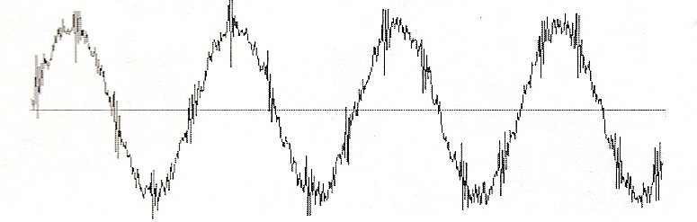
Vibration and the Sources
We can typically break vibration down to 4 main components:
  Forced vibration due to unbalance, misalignment, blade and vane pass, gear mesh, looseness, impacts, resonance, etc.
  Resonance response due to impacts.
  Stress waves or shock pulses.
  Frictional vibration.
7
VI –Southern Indiana
10/03/2013

Slide 8
What Are We Looking For?
Detection of a even the slightest metal-to-metal contact from impacting components or inadequate lubrication in a bearing.
A slight ringing caused by a bearing fault resonating a natural frequency in the machinery setup.
Presence of high-frequency, low-energy vibration.
  Sometimes noted as raising the “carpet level” in the noise floor in acceleration readings – especially at high frequency.
Capability to detect an incipient failure with senses that transcend normal human abilities .. sight, sound, touch, smell, etc.
Note: It is not important as to what natural frequency is excited; the measurement just needs to be repeatable.
8
VI –Southern Indiana
10/03/2013

Slide 9
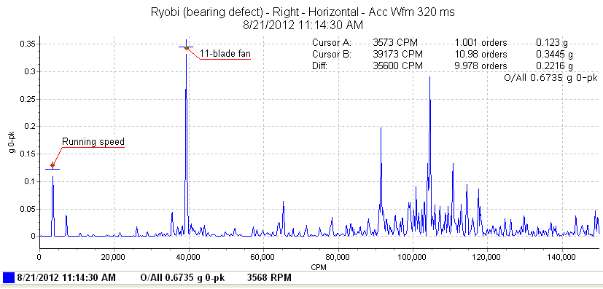
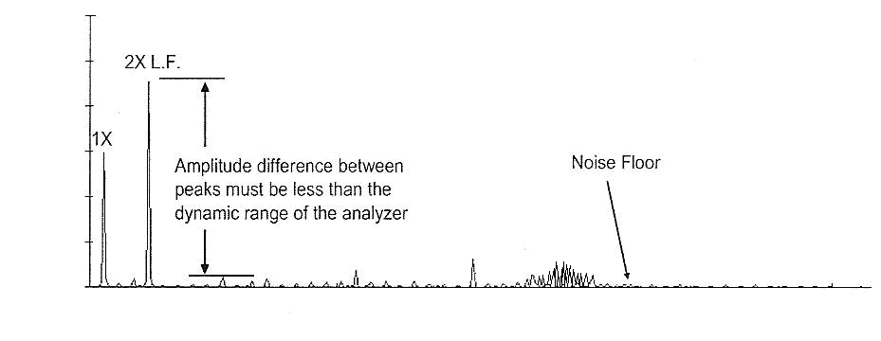
Tell-Tale Signs in Acceleration
Presence of very small peaks at High Frequency!
9
VI –Southern Indiana
10/03/2013

Slide 10
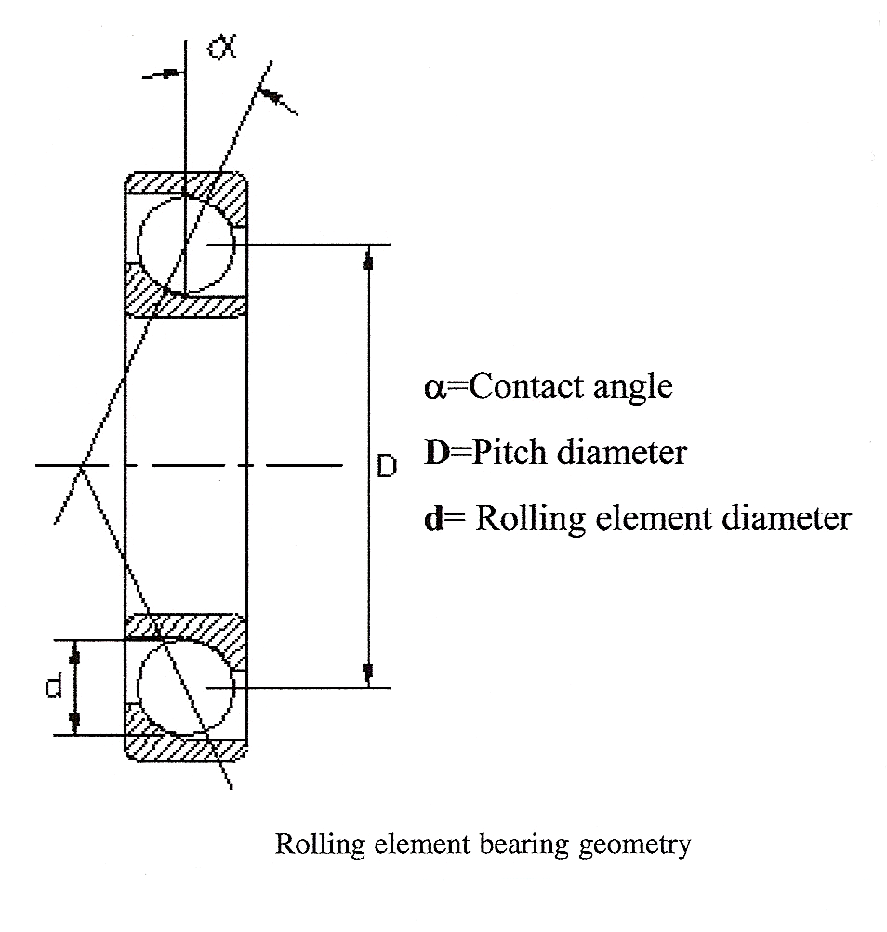
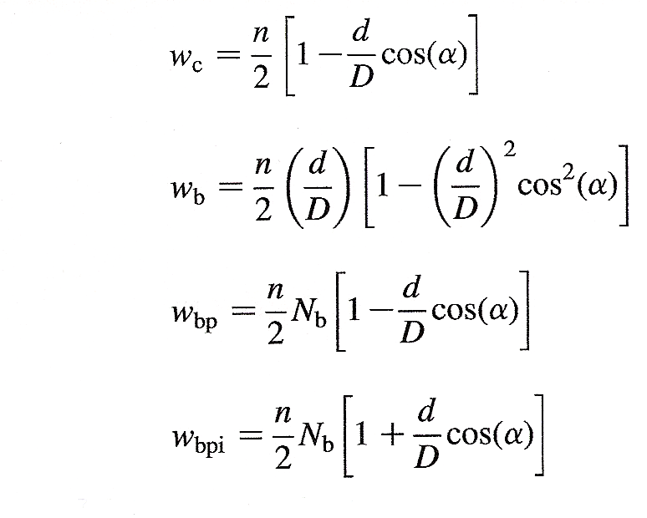
Fault Frequencies … Isn’t It Just Math?
Yes. Just know FTFI, BSF, BPFO, and BPFI.
fixed inner race
₊
(assumes a fixed outer race)
10
VI –Southern Indiana
10/03/2013

Slide 11
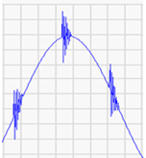

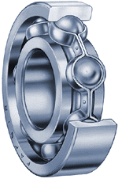
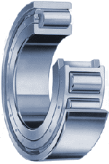
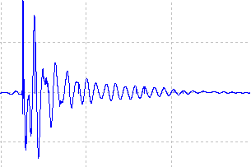
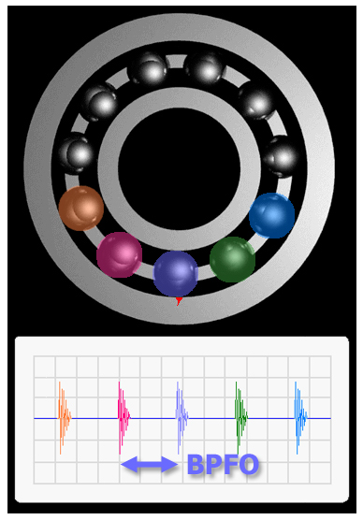
A Look at Geometry …
Impacts per Revolution
Ball Bearings
Roller Bearings
11
VI –Southern Indiana
10/03/2013

Slide 12
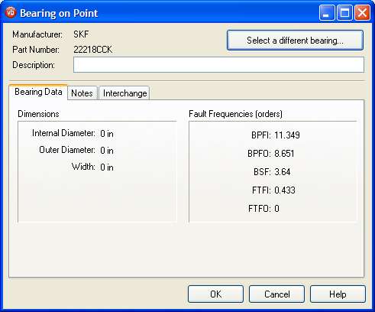
Fortunately .. It’s All Worked Out
Note: BPFI + BPFO = Number of Elements; typically a 60/40 relationship.
(See data at left. 11.349 + 8.651 = 20 rolling elements.)
Also, sometimes estimated as:
BPFI = N_{B}/2 + 1.2
BPFO = N_{B}/2 - 1.2
Non-Synchronous Frequencies
12
VI –Southern Indiana
10/03/2013

Slide 13
What Are The Typical Failure Stages?
STAGE 1:
  Presence of ultrasonic frequencies (typically well above 5KHz) that are barely detectable.
  Very low amplitudes appearing in the acceleration measurement.
  L₁₀ life remaining at this point is 10-20%
  Lubricate and monitor.
13
VI –Southern Indiana
10/03/2013

Slide 14
Typical Failure Stages?
STAGE 2:
  More ringing occurring, and presence of frequencies of 500HZ to 5KHz.
  Fault frequencies show up with modulation (sidebands).
  Time waveform of acceleration shows impacting (flat-topped or notched).
  L₁₀ bearing life down to 5-10%
  Lubricate and monitor.
14
VI –Southern Indiana
10/03/2013

Slide 15
Typical Failure Stages?
STAGE 3:
  Energy spreads more down the spectrum.
  Defect frequencies begin to be more prominent.
  More harmonics and sidebands show up.
  Wear tends to flatten out peaks and patterns.
  Bearing temperature increase is now apparent.
  It is time to order parts and start an action plan!
  L₁₀ bearing life is now 5% or less.
15
VI –Southern Indiana
10/03/2013

Slide 16
Typical Failure Stages?
STAGE 4:
  1X energy begins to increase as clearance is quite noticeable.
  Broadband spectral noise is evident by a raised noise floor.
  Failure is eminent!
  L₁₀ life has 1% remaining at best
  Replace immediately.
16
VI –Southern Indiana
10/03/2013

Slide 17
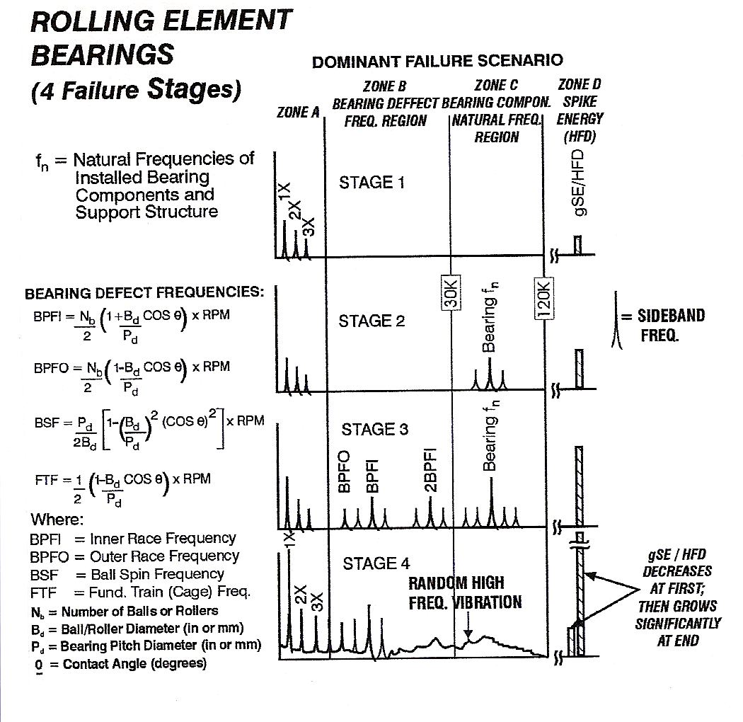
What Do The Experts Say?
ultrasonic
impacts and ringing
present
Courtesy of Technical Associates of Charlotte ©
17
VI –Southern Indiana
10/03/2013

Slide 18
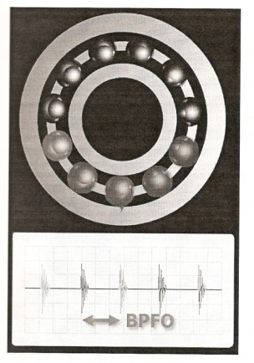
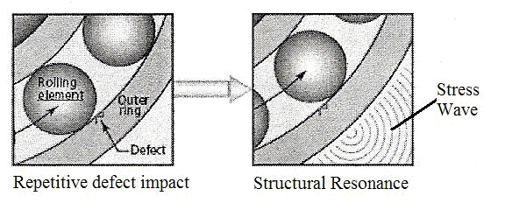
What Causes This Vibration Energy?
Contact between two metal surfaces.
A shock (or pressure) wave is created.
  Analogy is the wave set up by an earthquake or tsunami.
  A ripple from a pebble tossed in a pond is another example.
Resulting signal propagates through the metal surfaces when there are no air gaps to filter (good metal-to-metal contact).
18
VI –Southern Indiana
10/03/2013

Slide 19
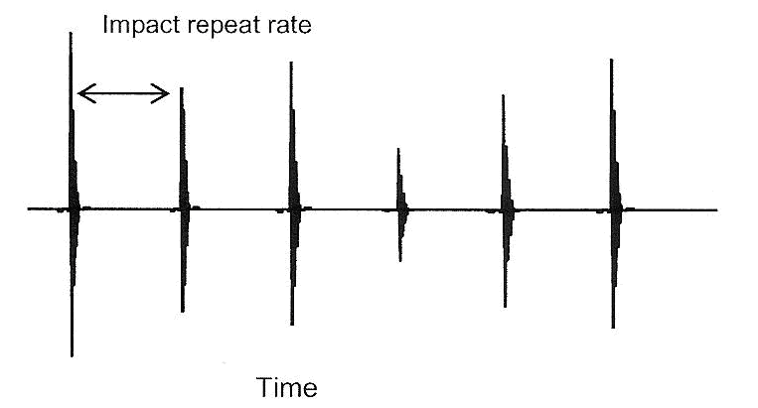
How Can We Detect Early Signs?
Special instrumentation and detection circuits.
Special signal processing.
Detection of small spikes with short duration and ringing characteristics.
A small tell-tale signal in the presence of lots of noise and higher amplitudes (a high dynamic range > 95dB).
Accelerometer with a solid mounting.
Good measurement practices.
Special measurement for defect detection, plus normal readings in 3 axes.
19
VI –Southern Indiana
10/03/2013

Slide 20
How Have Solutions Suppliers
Addressed This Need?
Lots and lots of competitive and complementary offerings, some dating back to the early 70’s:
  Spike Energy™ and Spike Energy Spectrum™
  ESP™ ( Envelope Signal Processing)
  HFD ™ (High Frequency Detection)
  SEE ™ ( Spectral Emitted Energy)
  PeakVue ™
  Shock Pulse ™
  Stress Waves
  Enveloping (or Demodulation)
  Cepstrum
20
VI –Southern Indiana
10/03/2013

Slide 21
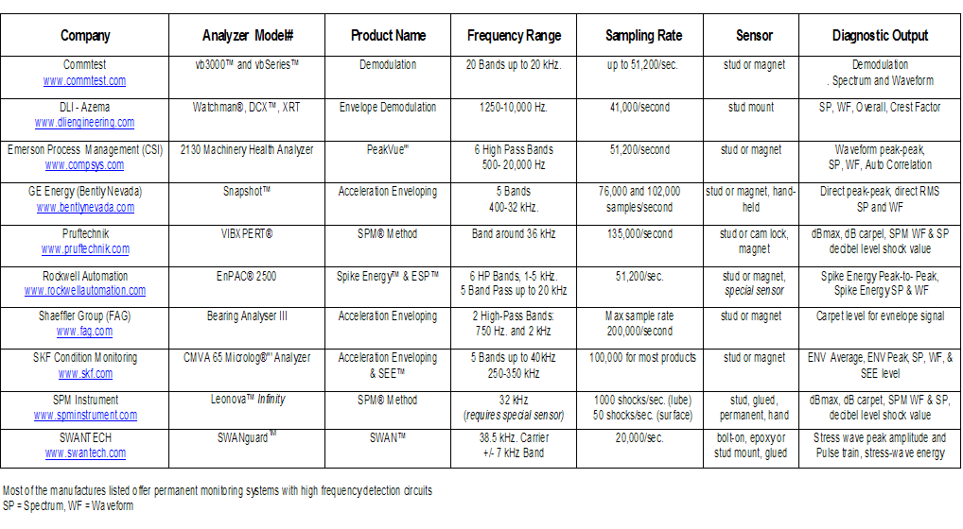
The Choices
21
VI –Southern Indiana
10/03/2013

Slide 22

Is There a Common Thread?
All methods are based on a fundamental concept: There are repetitive impacts in the machine structure that indicate bearing faults, gear damage, looseness, cavitations, and similar faults.
Machine/bearing resonances (or sensor resonance) are excited by the impacts – similar to striking a bell.
Repetitive fault frequencies can be identified with special signal processing – filtering, peak detection, and frequency analysis.
Careful measurement and collection methods are essential to enable this technique.
Advanced signal processing technology and instrumentation available today make this a proven analysis tool in routine data collection programs for Predictive Maintenance (PdM).
22
VI –Southern Indiana
10/03/2013

Slide 23
What Do We Need To “See”?
Spikes from impacts.
Ringing from a natural resonance being excited.
Demodulation (or other method) to determine and “see” the repeated fault frequency.
Frequency Determination on “Impact Rate” to isolate the fault.
the impact and ringing
23
VI –Southern Indiana
10/03/2013

Slide 24
What Are the Basic Requirements?
Solid Transducer Mounting.
Mounting Target and Orientation Maintained.
Mounted in Load Zone of Bearing Housing.
Best Possible Mechanical Interface for Transmission of Energy.
High Frequency Energy Detection Method.
Detection of Repeated Fault and Ringing Condition.
Ability to Strip Out Low Frequencies Associated with Actual Running Speed.
Ability to Demodulate (Envelope) Signal or Determine the Peaks of the Repetitive Fault Frequency.
Ability to Detect Repetition Fault Frequency.
Ability to Show Resulting Signature (FFT) and compare the pattern to published data.
High-pass – Repetitive Peaks in TWF – Low-pass – FFT
24
VI –Southern Indiana
10/03/2013

Slide 25
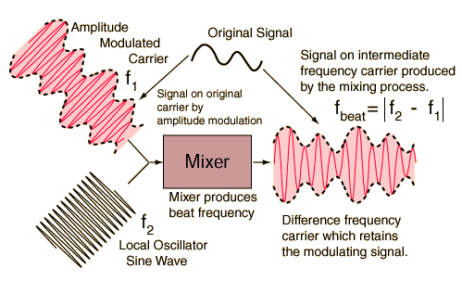
What Does “Demodulation”
Really Mean?
It is analogous to stripping out the information from an AM radio broadcast.
  Spanning the band for the station frequency (540-1600 KHz) and picking off the broadcasted signal.
First need to incorporate a high-pass or band-pass filtering.
Eliminate any high amplitude signals associated with 1X and multiples up to about 10X.
Include only the fault frequencies exciting inherent resonance.
Intensify and draw out repetitive components of the fault.
Convert to frequency for display of the pattern.
Amplitudes will show up as a distinctive “saw-tooth” or “comb” harmonic pattern of the actual bearing fault.
25
VI –Southern Indiana
10/03/2013

Slide 26
Impact events
generate high-freq
pulses.
We see...
We don’t see…
(but would like)
X
vibration
vibration
BPFO
BPFO
time
time
BPFO
frequency
frequency
26
VI –Southern Indiana
10/03/2013

Slide 27
The raw signal includes low frequency running speed harmonics:
These are removed by high-pass (or band-pass) filtering:
With envelope detection is applied:
rectified
enveloped (demodulated)
Finally the result is displayed in the frequency domain:
BPFO
The “comb” or “saw tooth” pattern.
27
VI –Southern Indiana
10/03/2013

Slide 28
Difference in Processing
Demod 1
Demod 2
rectified
enveloped (demodulated)
rectified
decimated and averaged
Processing applied:
BPFO
vs.
28
VI –Southern Indiana
10/03/2013

Slide 29
Can The Readings Be Trended?
Yes, but consistency of measurement is of utmost importance.
  Same hardware.
  Same measurement location.
  Solid mounting in good mechanical transfer path.
  Same conditions.
  Baseline and set alarms.
Note: Each vendor technology will typically require a different baseline.
29
VI –Southern Indiana
10/03/2013

Slide 30
A Case History Example …
Automotive paint facility
250 HP motors running 6-foot bladed exhaust fans.
Motor running at 1792 RPM.
Fan belt driven and running at 820 RPM.
Bearings known.
Excessive vibration reported.
Initial measurements made of vibration with acceleration, velocity, and demodulation.
Source of problem is identified, corrective action is recommended.
Bearing SKF 22218CCK changed out at next production break.
Let’s take a look at initial results first, then Before/After comparisons.
30
VI –Southern Indiana
10/03/2013

Slide 31
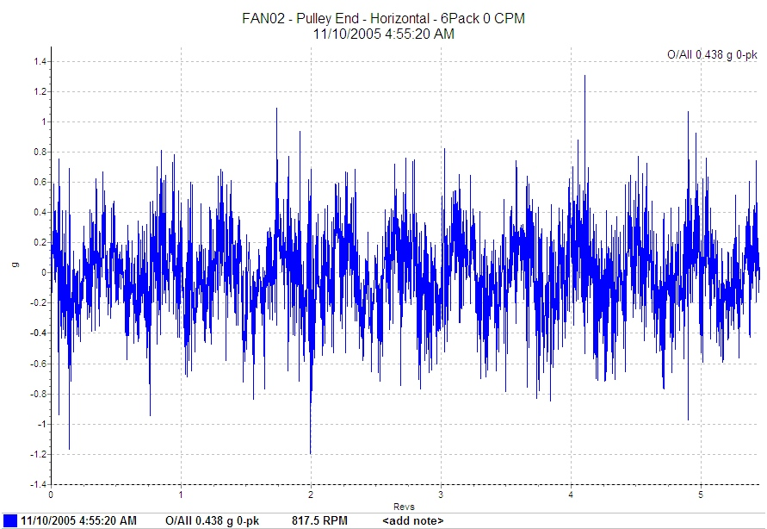
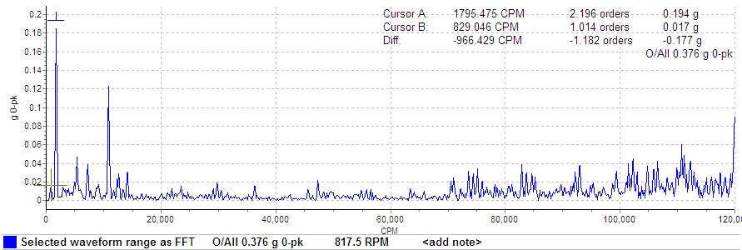
First, the Acceleration Reading
classical lifting of noise floor at high frequencies
31
VI –Southern Indiana
10/03/2013

Slide 32
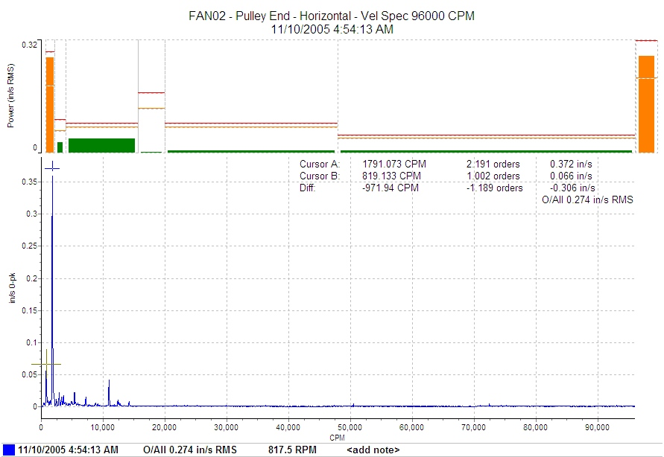
Next, Velocity
High running speed components
32
VI –Southern Indiana
10/03/2013

Slide 33
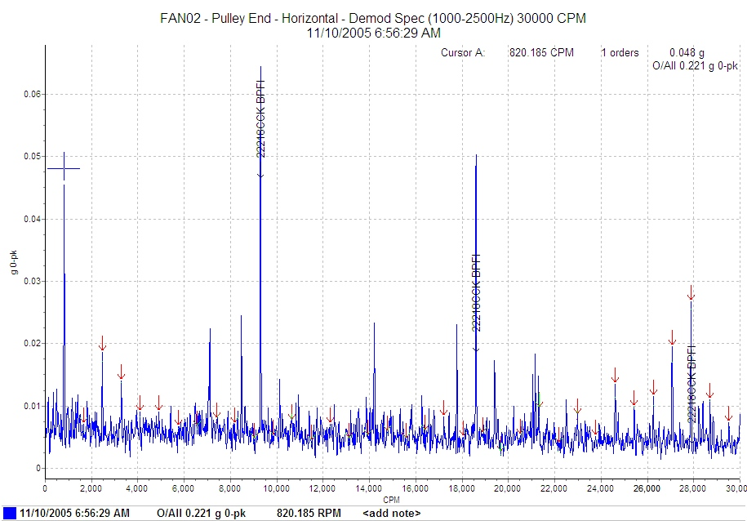
Now, Demodulation
dominant BPFI fault frequency
33
VI –Southern Indiana
10/03/2013

Slide 34
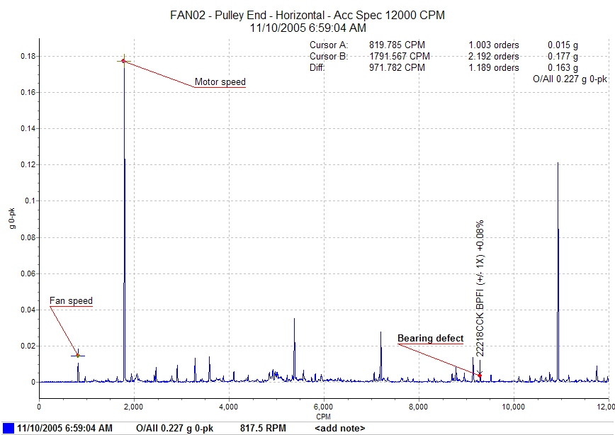
After the Fact, but not obvious
34
VI –Southern Indiana
10/03/2013

Slide 35
Velocity – Before and After
Note the significant reduction in amplitude.
35
VI –Southern Indiana
10/03/2013

Slide 36
Acceleration – Before and After
Note the reduction of the high-frequency energy.
36
VI –Southern Indiana
10/03/2013

Slide 37
Demodulation – Before & After
classical “comb” pattern
Note that the distinctive peaks are gone!
37
VI –Southern Indiana
10/03/2013

Slide 38
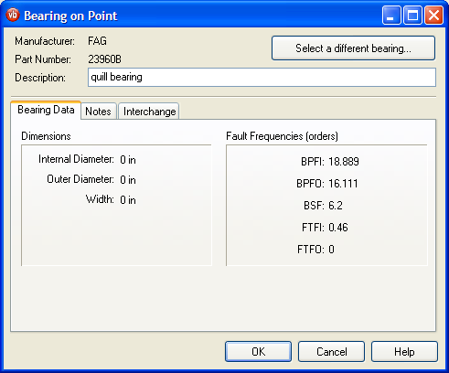
Another Recent Finding
Low speed machine turning at 394 RPM.
Bearing known as FAG 23906B.
Fault frequencies known:
  BPFI is 18.889
  BPFO is 16.111
  BSF is 6.2
  FTFI is 0.46
Low vibration amplitudes, but somewhat noisy.
High frequency acceleration data was taken along with routine measurements, no demod.
38
VI –Southern Indiana
10/03/2013

Slide 39
First, The High Frequency Data
5KHz and above resonances with sidebands
39
VI –Southern Indiana
10/03/2013

Slide 40
Next, the Time Waveform
Repetitive spiking at BPFI
40
VI –Southern Indiana
10/03/2013

Slide 41
Finally, the FFT with Overlays
BPFI Fault Frequency is evident
41
VI –Southern Indiana
10/03/2013

Slide 42
Pre-requisites and Procedure
Bearing part number(s) must be known.
Fault frequencies must be known and preloaded.
Running speed must be accurately recorded.
Bearing faults excite natural resonances in the machine components or transducer.
The fault frequency is recurring.
A technique is available to detect the repetition rate in time.
The fault frequency (if present) can be shown in an FFT display with bearing data overlays.
3 Musts
42
VI –Southern Indiana
10/03/2013

Slide 43
Summary Remarks
Rolling-element bearing failures can be catastrophic.
While there are 4 defined stages of failure, there is no step-by-step progression.
A defective bearing does not fix itself!
Machinery vibration measurements in time waveform and spectrum can provide early (tell-tale) signs of rolling element bearing defects.
Special signal processing techniques (now available in most portable data collectors) can detect impacting spikes and pinpoint a specific fault frequency.
Comparing the resulting signature (pattern) to published fault frequencies can pinpoint the root cause of the problem.
Field experiences in PdM over the past 30 years have proven the concepts to be very accurate and reliable.
Considerable cost savings (in maintenance and production) are afforded by use of this technology.
43
VI –Southern Indiana
10/03/2013

Slide 44
Questions / Discussion
on
Rolling Element Analysis?
Dennis Shreve
Dennis.shreve@ge.com
Commtest Instruments
44
VI –Southern Indiana
10/03/2013

